Slide 1
Binary Search Tree (BST) (Properties, insertion, sorting, traversals, min, max, search)

Slide 2
Overview
Binary trees Ch 12.2–3
Trees Ch 10.4, 12.1

Slide 3
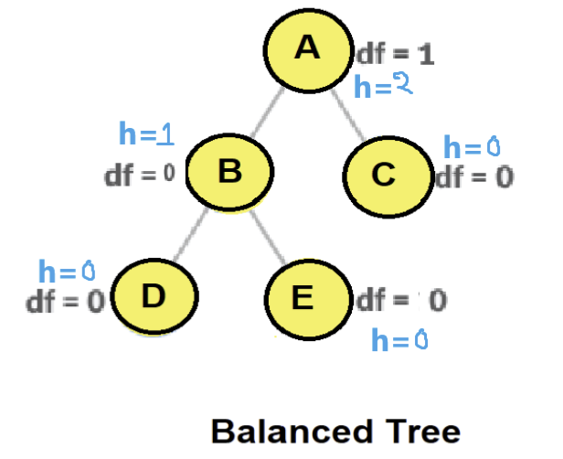
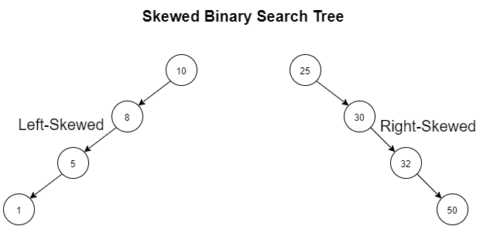
Binary-search-tree (BST)
Powerful data structures for dynamic-set operations
E.g., dictionaries or priority queues
Basic operations (insert, delete, search) take time proportional to height of tree
Operations: insert, delete, search → O(h)→O(logn) , where h is the tree height.
balanced BST with n nodes: worst case θ(h)= θ(logn)
Linear chain of n nodes/ skewed tree: worst case θ(h)=θ(n)
Binary trees Ch 12.2–3

Slide 4
Binary-search-tree
In practice, more advanced binary trees required to keep trees balanced over time (not skewed), e.g. B-trees, red-black-trees
For BST, nodes will have have (style2)
key or value
parent
left child
right child
Root has no parent
Leaves have no children
Binary trees Ch 12.2–3

Slide 5
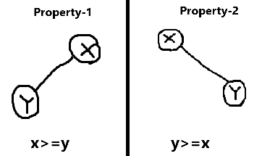
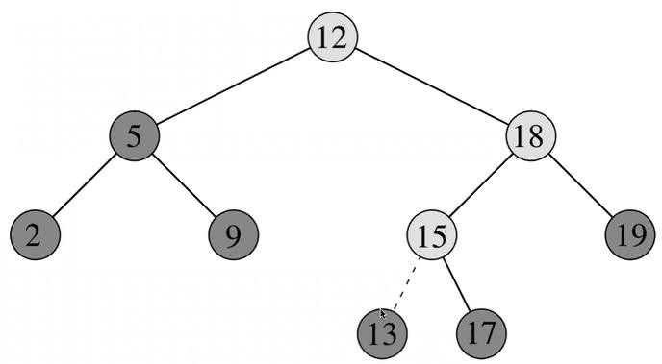
Binary-search-tree property (BSTP)
Binary tree with the following property is called BST:
If for any two elements x and y the following holds: -
Property1: If y is in the left subtree of x, then:
y.key ≤ x.key
Property2: If y is in the right subtree of x, then
y.key ≥ x.key
Binary trees Ch 12.2–3

Slide 6
Binary-search-tree property (BSTP)
Binary tree with the following property is called BST:
Property 3: The left and right subtree each must also be a binary search tree.
Property 4:Each node must have a distinct key, which means no duplicate values are allowed. (Optional property)
The goal of using BST data structure is to search any element within O(h) = O(log(n)) time complexity.
Binary trees Ch 12.2–3

Slide 7
Insertion
We have some new node z with z.key = v to insert into tree
Always insert as a new leaf
Must maintain binary-search-tree property (BSTP)
insert to the right of all nodes with larger key
insert to the left of all nodes with smaller key
Binary trees Ch 12.2–3

Slide 8
Insertion 7
Binary trees Ch 12.2–3

Slide 9
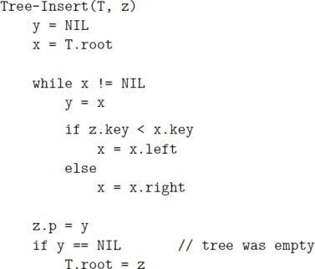
Insertion (code explanation)
y is parent of node we currently inspect
While loop descends through tree moving into correct subtree at each step
Last part links node and parent
Binary trees Ch 12.2–3

Slide 10
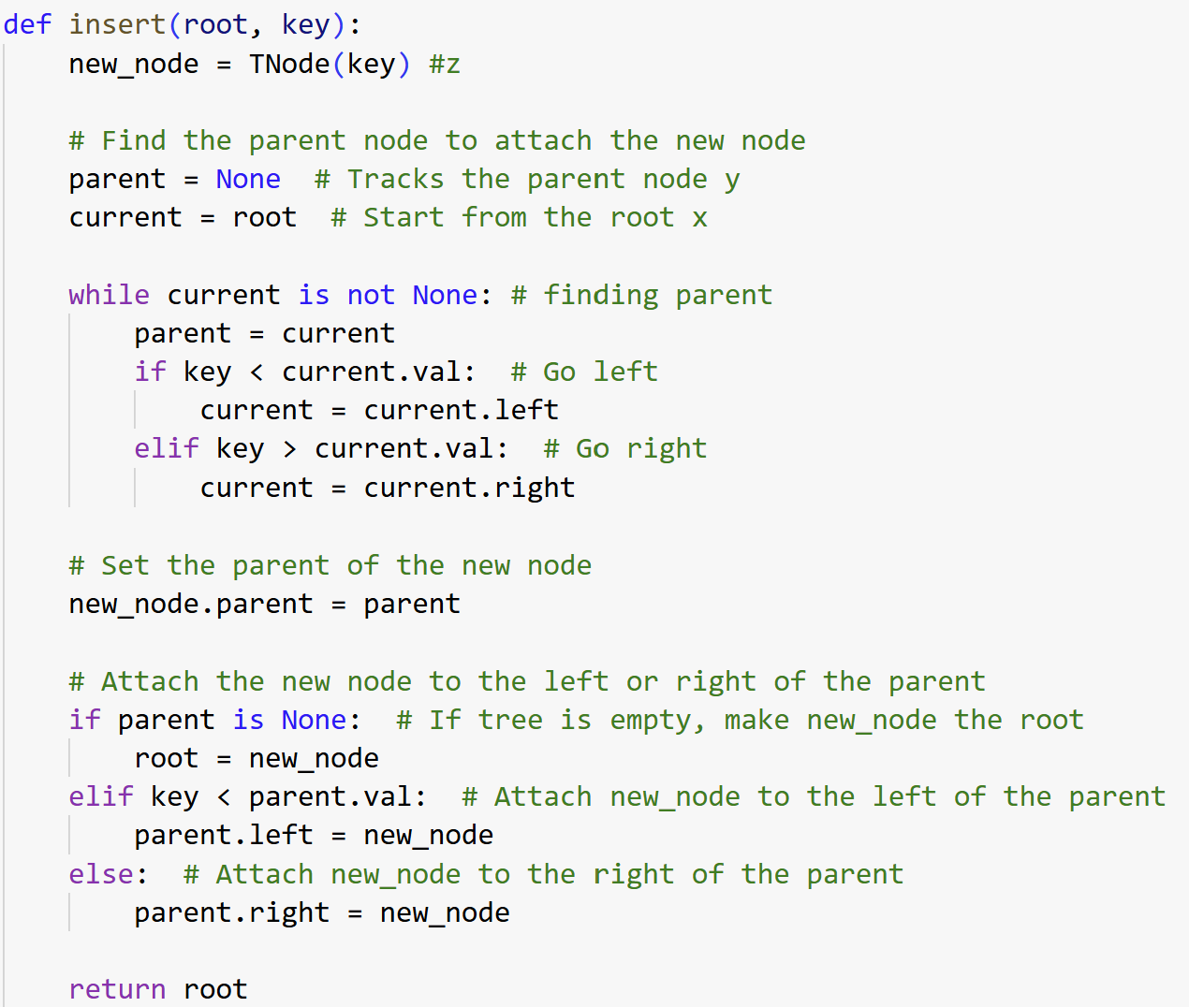
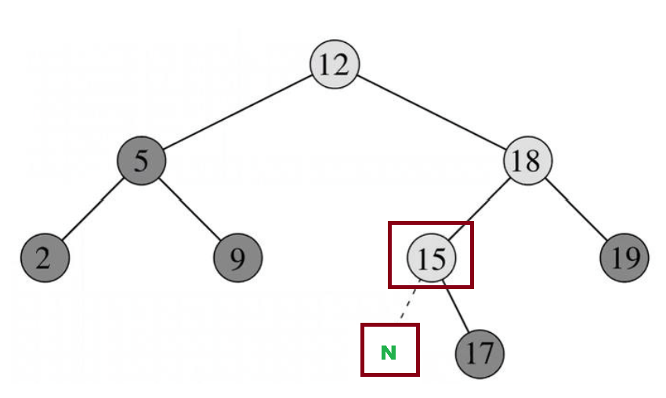
Insertion (code explanation)
Insert 13
Binary trees Ch 12.2–3

Slide 11
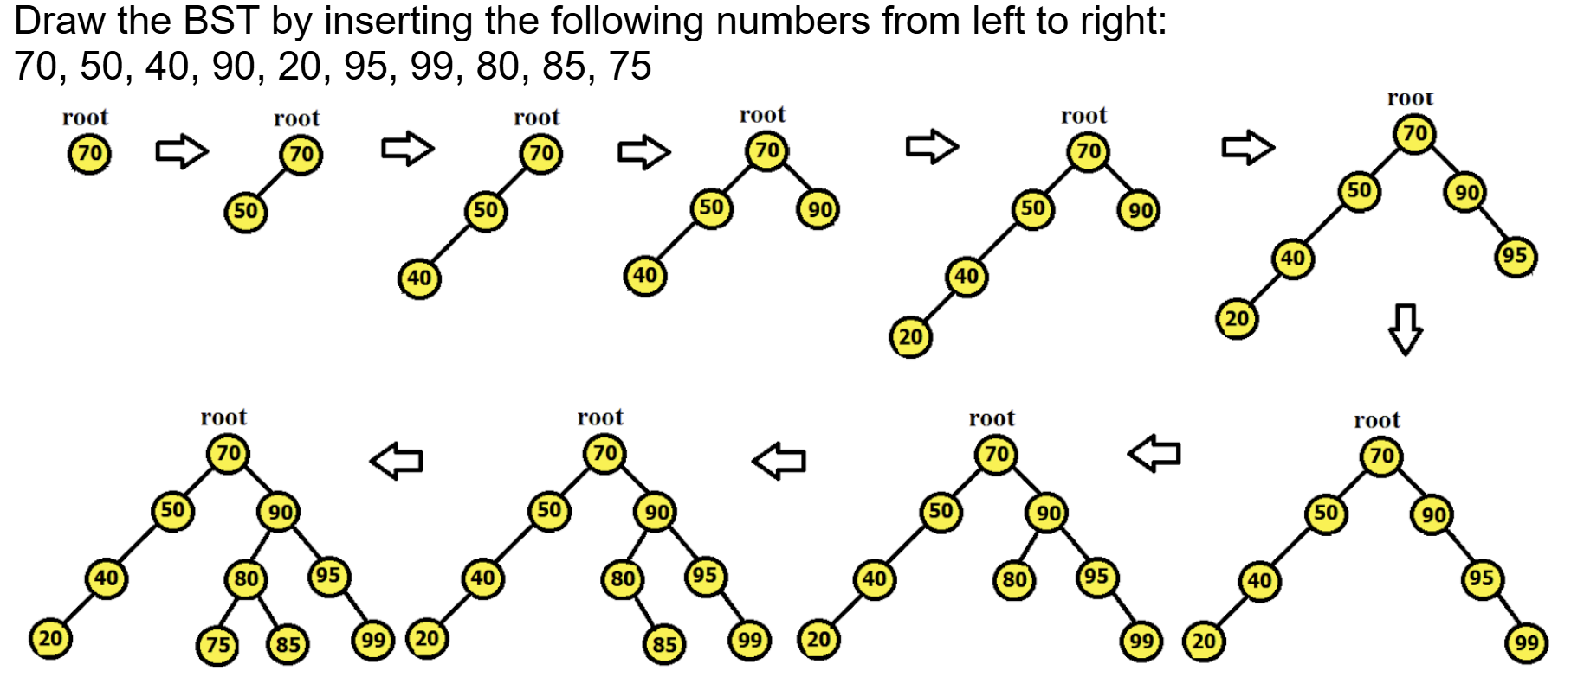
BST creation using insertion
Binary trees Ch 12.2–3

Slide 12
BST creation using insertion
Binary trees Ch 12.2–3

Slide 13
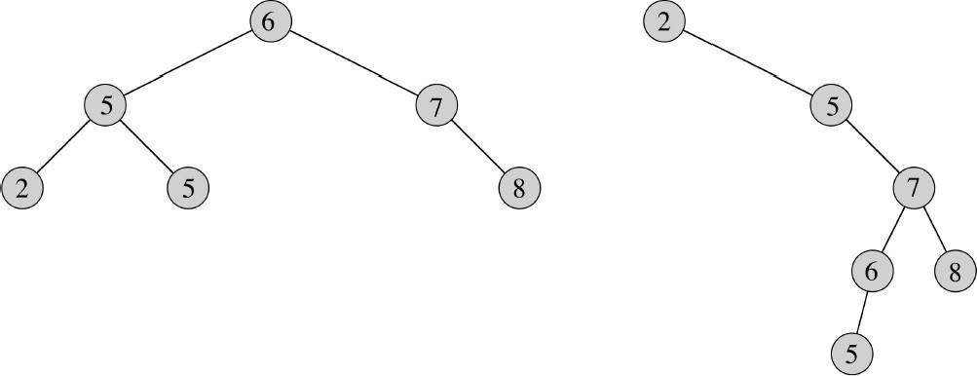
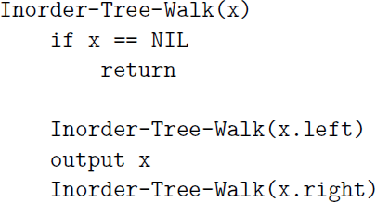
Inorder tree walk
Walk through tree in a way that outputs each node between its left and right subtree (Left, Root, Right)
For BST, this will output nodes in increasing order of keys (ASCENDING)
Start at root node
Time complexity: We visit each node exactly once and perform a single operation, thus time complexity will be θ(n).
Binary trees Ch 12.2–3

Slide 14
Tree walk
Pre- and post-order walks
Pre-order: output each node before visiting left, then right subtree (Root, Left, Right)
Post-order: visit left, then right subtree, then output node (Left, Right, Root)
Time complexity: We visit each node exactly once and perform a single operation, thus time complexity will be θ(n).
Binary trees Ch 12.2–3

Slide 15
BST Traversal (Important)
In-order traversal generates ASCENDING Ordered values
(Left root right)
Reverse In-order traversal generates DESCENDING Ordered values
(Right root Left)
Binary trees Ch 12.2–3

Slide 16
Tree Sort
Tree sort is a sorting algorithm that is based on Binary Search Tree data structure. It first creates a binary search tree from the elements of the input list or array Then performs an inorder traversal on the created binary search tree to get the elements in sorted order.
Algorithm:
Step 1: Take the elements input in an array Step 2: Create a Binary search tree by inserting data items from the array into
the binary search tree.
Step 3: Perform in-order traversal on the tree to get the elements in sorted order. Ascending
Binary trees Ch 12.2–3

Slide 17
BST creation using insertion
Step01: Take the elements input in an array. (70, 50, 40, 90, 20, 95, 99, 80, 85, 75 0 1 2 3 4 5 6 7 8 9 10
Binary trees Ch 12.2–3

Slide 18
BST creation using insertion
Step02: Create a Binary search tree by inserting data items from the array into
the binary search tree.
Binary trees Ch 12.2–3

Slide 19
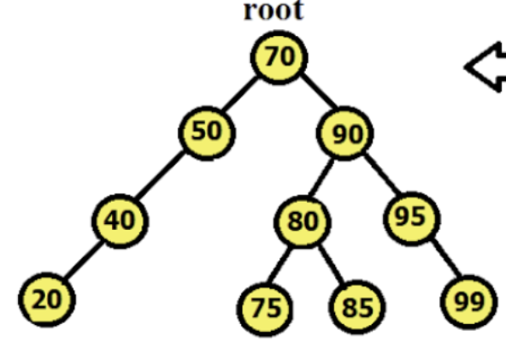
Tree Sort
Step 3: Perform in-order traversal (Left, root, right) on the tree to get the elements in sorted order.
20 40 50 70 | 75 80 85 | 90 | 95 99
Binary trees Ch 12.2–3

Slide 20
Tree Sort
Time complexity: Complexity of each element insertion when tree is balanced is O(h) = O(logn)
Hence, the complexity of n element insertion will be O(n x logn) = O(nlogn) Complexity of each element insertion when tree is unbalanced (skewed) is O(h) = O(n)
Hence, the complexity of n element insertion will be O(n) x O(n) = O(n^2) Best & average case: O(n*logn), if tree nearly balanced Worst case: O(n^2), if its is a skewed tree
Binary trees Ch 12.2–3

Slide 21
Min and Max of BST
Time complexity is O(h), where h is height of tree
Minimum is leftmost leaf (Time is O(h) = O(logn) [when balanced])
Maximum is rightmost leaf (Time is O(h) = O(logn) [when balanced])
Binary trees Ch 12.2–3

Slide 22
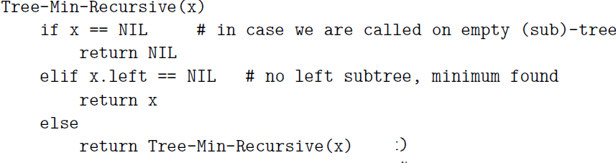
Minimum of BST
Recursive solution
This algorithm is an example of tail recursion. Since each function call comes with an overhead, it is often more efficient to eliminate tail recursion and replace it by a loop.
Binary trees Ch 12.2–3

Slide 23
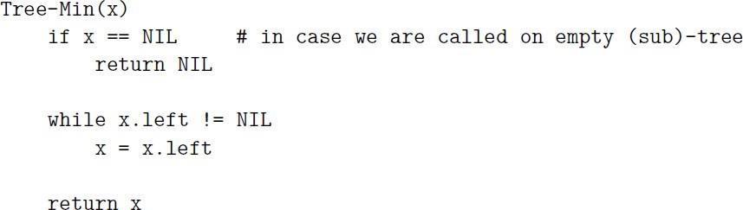
Minimum of BST
Iterative solution
Binary trees Ch 12.2–3

Slide 24
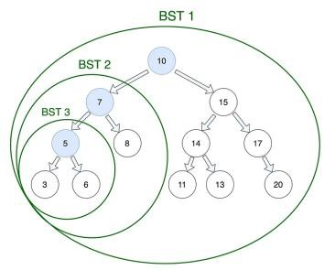
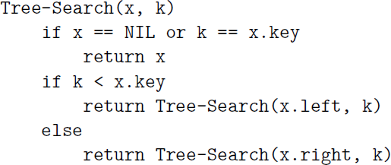
Search
Find Key=5
Time complexity is O(h) = O(logn) [when balanced], where h is height of tree
Binary trees Ch 12.2–3

Slide 25
Search 27
Height of this tree is =3 In BST, comparisons/steps = 3 In array, comparisons/steps = 11 Better BST for search
Binary trees Ch 12.2–3

Slide 26
Try out Interactive Simulation by Visualgo.net (https://visualgo.net/en/bst)
Interactive simulations

Slide 27
The End

